Slide 1

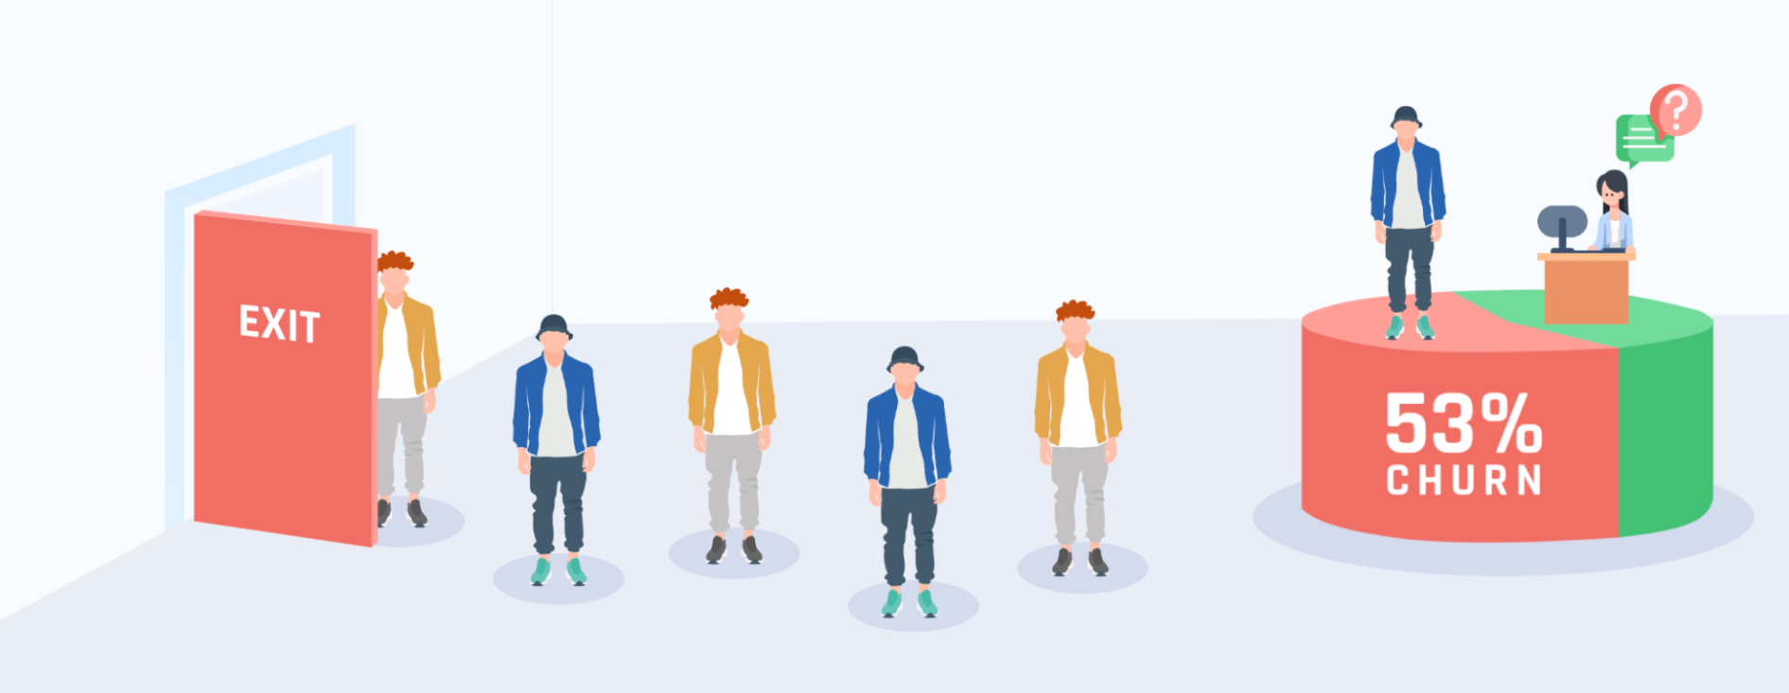

Churn Prediction Using
24.04.2023
Amit Vaxberg 208464602 | Sean Agami 305070690 | Chen Ben Shalom 204594626
TCBDA-18

Slide 2




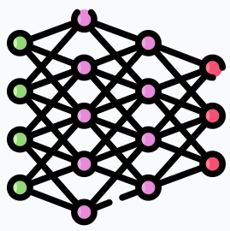

Roadmap
Use Case Introduction
Data Cleaning
Features Engineering
1
3
5
2
4
6
Dataset understanding using EDA
Correlations with Label
Model Evaluation

Slide 3
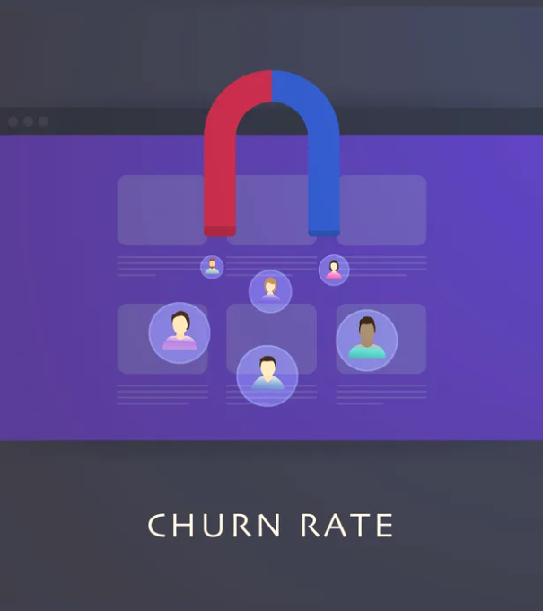
01 Introduction
Churn rate is referred to as the proportion of contractual or subscribed customers who terminate their relationship with a service provider.
Businesses must predict future churn rates because it helps them to perceive a better understanding of future expected revenue.
In this project, we had the opportunity to explore a telecommunication company’s dataset consists of past and existing customers, as well as to create a model which predicts potential future churns.

Slide 4
THE PROBLEM
Will this customer churn?
It’s inadequately possible to predict whether a new or an existing customer is likely to churn in the future.
What does affect churn?
The need to understand which factors or features drive customers to churn.

Slide 5
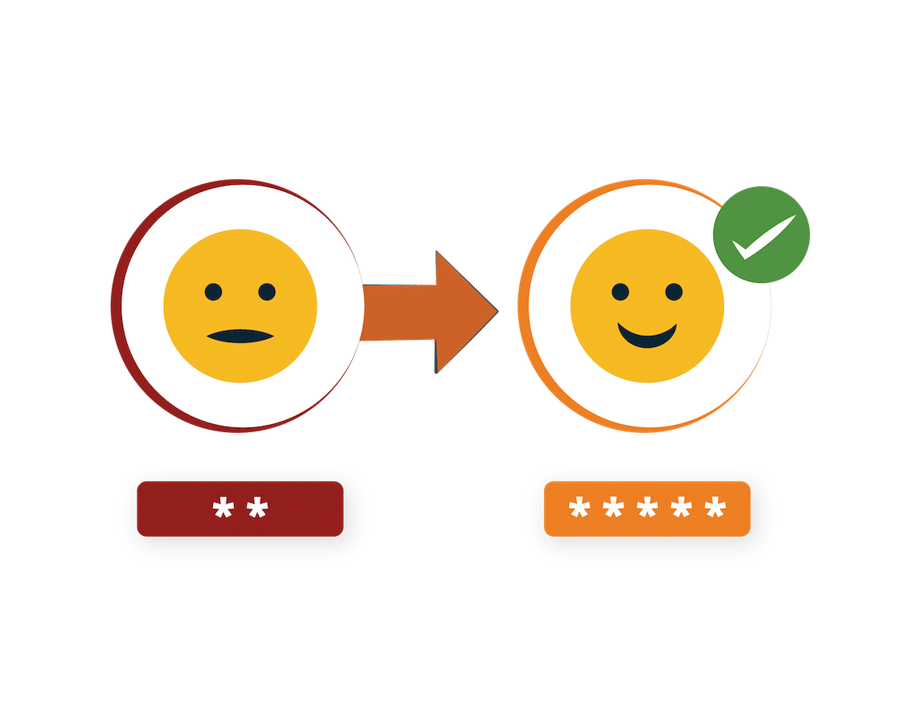





THE MOTIVATION
Customer churn rate is a key metric for businesses looking to scale.
Acquisition Costs
It’s up to 5 times cheaper to retain current customers than acquiring new ones.
Sales Opportunities
The probability of making a sale to an existing customer is 60-70%.
Brand Reinforcement
Retaining current customers increases word-of-mouth recommendations and loyalty.
Profitability
A higher customer retention rate leads to greater profits and lifetime customer value (LCV).
Competitive Advantage
Long-term customers can provide useful data and feedback for future brand campaigns and strategies.

Slide 6
THE SOLUTION
Creating a predictive model using ‘Churn.csv’ dataset, statistical algorithms and machine learning techniques to identify the likelihood of future churns based on historical data
The goal is to go beyond knowing what has happened to providing a best assessment of what will happen in the future

Slide 7

02 EDA
Exploratory Data Analysis refers to the critical process of performing initial investigations on data to:
discover patterns and correlations
spot anomalies
test hypothesis
check assumptions
with the help of summary statistics and graphical representations.

Slide 8

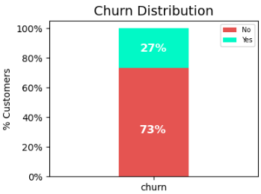

About The Dataset – ‘Churn.csv’
Category | Details
File Structure | 21 columns (4 numeric, 16 categorical, 1 unique ID) and 7043 sample rows
Features/Label Ratio | 19 features and 1 label
Business Context | A customers database of past and existing customers who subscribed to a variety of telecommunication services

Slide 9






Churn Dataset Fields
Information Type | Relevant Columns
Unique Identifier | CustomerID
Demographic | Gender, SeniorCitizen, Partner, Dependents
Core Customer Services | PhoneService, MultipleLines, InternetService
Extra Customer Services | OnlineSecurity, OnlineBackup, DeviceProtection, TechSupport, StreamingTV, StreamingMovies
Customer Account | Tenure, Contract, PaperlessBilling, PaymentMethod, MonthlyCharges, TotalCharges
Churn Status | Churn (Yes/No)

Slide 10
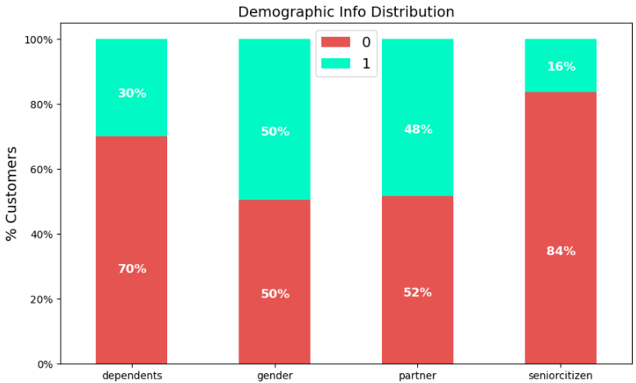
Demographic Info
Plot Insight:
Most of the clients are equally split between males and females, young, unmarried and childless

Slide 11
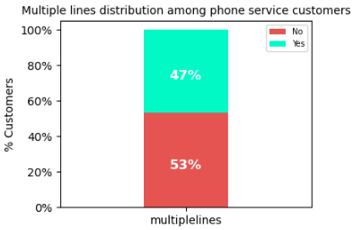
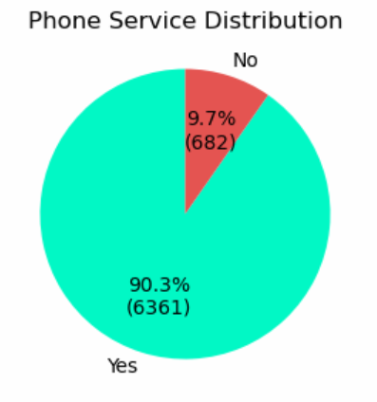
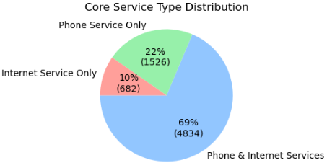
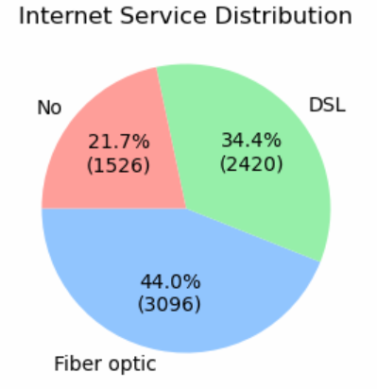
Core Customer Services
Plots Insights:
Most of the clients have -
phone service, but no multiple lines configuration
internet service and ‘Fiber optic’ is the most popular one
both internet and phone subscriptions

Slide 12
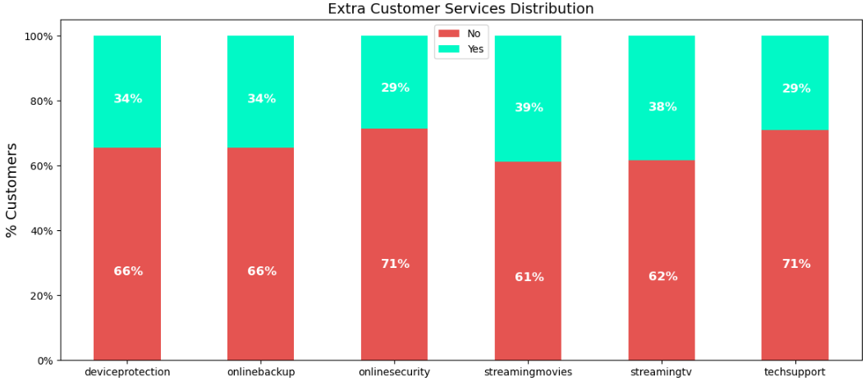
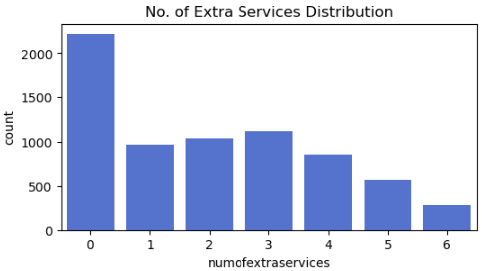
Extra Customer Services
Plots Insights:
Streaming Movies and Streaming TV are the 2 most popular add-on services
Most clients subscribed to at least 1 additional service
6 additional services are available to a small number of clients

Slide 13
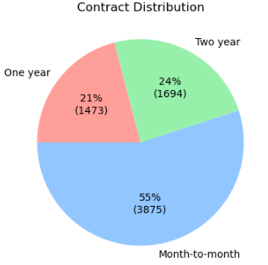
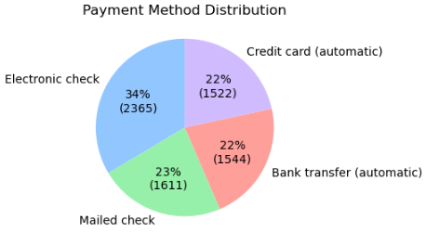
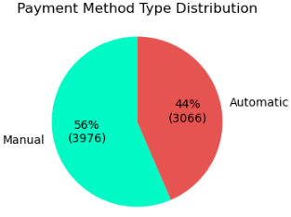
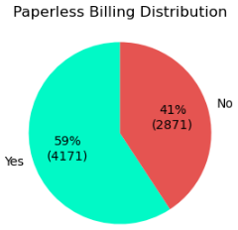
Customer Account [1/2]
Plots Insights:
'Month-to-month' contracts are used by more than half of the clients
Electronic check, which a third of clients utilize, is the most common payment method
Most clients receive paperless billing and prefer manual payment methods

Slide 14
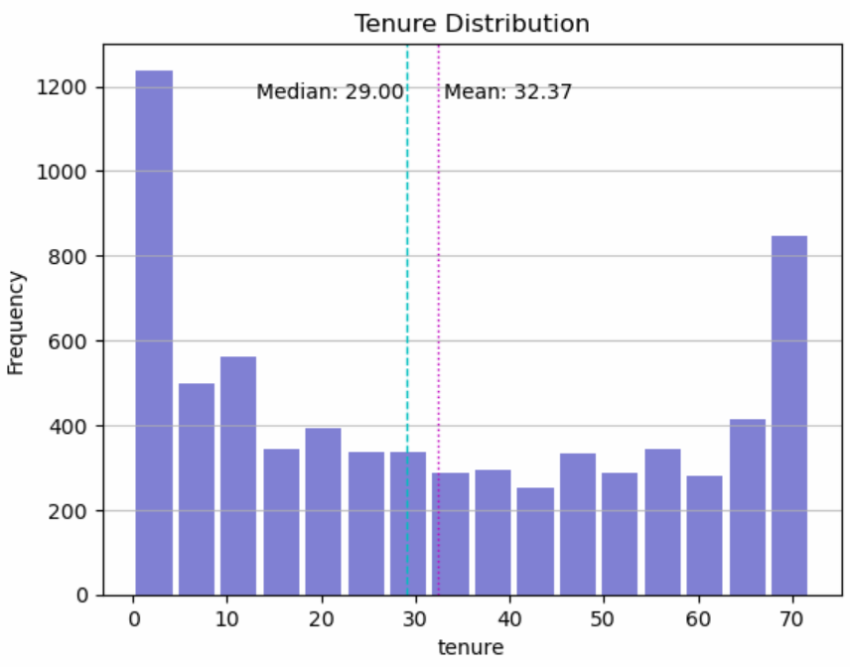
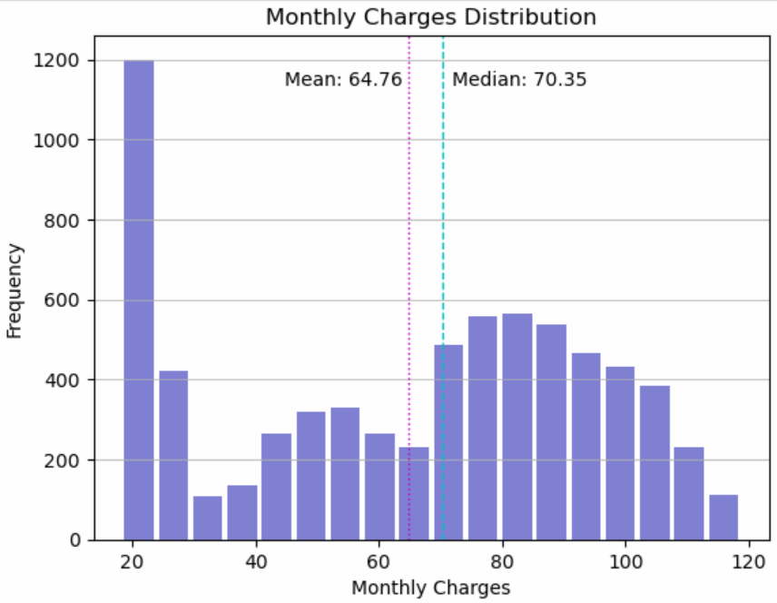
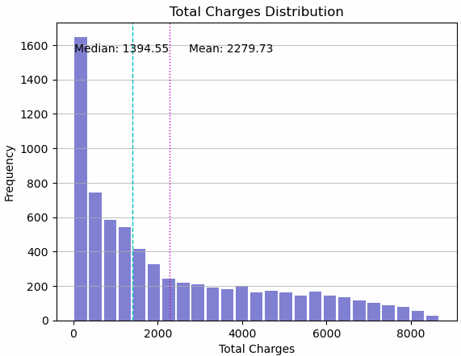
Customer Account [2/2]
Plots Insights:
Although the Average Customer Lifespan (ACL) is 32.37 months, half of the clients have a lifespan of less than or equal to 29 months
The average monthly fee is $64.76, while half of the clients pay a monthly fee of $70.35 or less
The average total fees paid by clients is $2,279.72, but half of them pay only $1,394.55 or less

Slide 15

Data Errors Found
TotalCharges column has 11 missing values
TotalCharges column has incorrect data type ‘object’
SeniorCitizen column is represented by numeric values instead of categories
Multiple columns have redundant values (‘no phone service’ and ‘no internet service’)
Inconsistent column names which contradict the best practice (mixture of uppercase and lowercase letters)

Slide 16

03 Data Cleaning
This process involves handling the issues detected during EDA.
These steps include:
renaming columns
replacing missing and redundant values
columns data types transformation
changing values to correct format

Slide 17

Data Errors Correction
TotalCharges column’s missing values were replaced with 0 because these rows probably represent new clients whose payments haven't been charged yet
TotalCharges column’s data type was changed to float
SeniorCitizen column’s values were converted from 0/1 to “No”/”Yes” respectively
Redundant values (‘no phone service’ and ‘no internet service’) were converted to ‘no’
All columns were renamed as lowercase

Slide 18

04 Correlations with Churn
So far, we have examined the features and label distributions in order to become familiar with our data set.
In this section, we aimed to assess how well the features and the label (churn) are related.

Slide 19
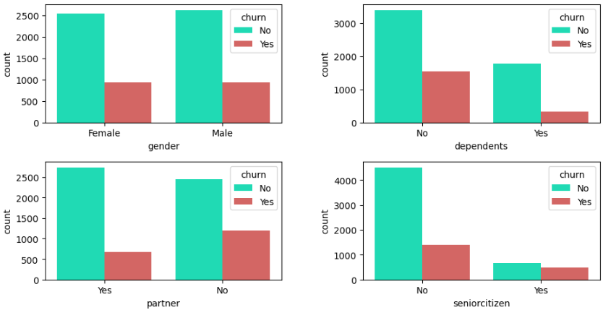
Demographic Info and Churn
Plots Insights:
Since both males and females experience churn at the same rate, gender has a minor effect on churn
Clients without dependents typically churn less frequently than clients with dependents do
Compared to younger clients, older adults tend to churn more frequently
The churn rate for single clients is higher than that for married clients

Slide 20
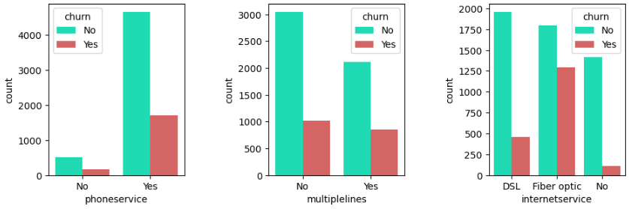
Core Customer Services and Churn
Plots Insights:
Since both phone subscribers and non-phone subscribers experience churn nearly at the same rate, phone service has no substantial effect on churn
Clients with multiple lines service have higher churn rate
Clients with ‘Fiber optic’ internet service tend to significantly churn more frequently, compared to clients with ‘DSL’ and those without internet service

Slide 21
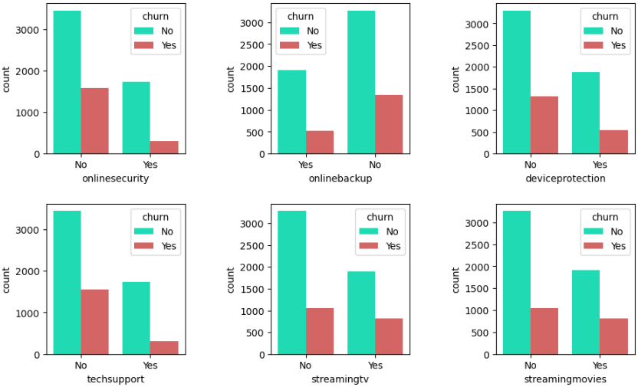
Extra Customer Services and Churn
Plots Insights:
Clients who utilize the following services are less likely to churn than those who do not:
Online security
Online backup
Device protection
Tech support
Surprisingly, we noticed an opposite trend when it comes to streaming TV and movies: clients who utilize these services churn at a higher rate than those who don't

Slide 22
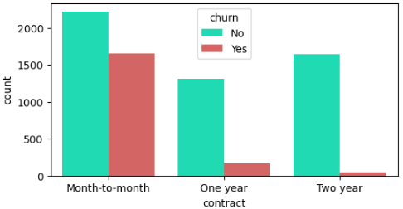
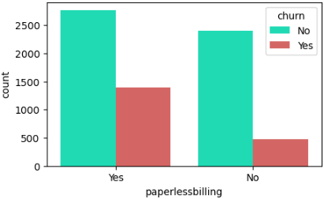
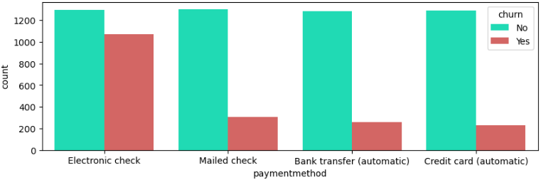
Customer Account and Churn [1/2]
Plots Insights:
Clients with ‘Month-to-month’ contract are significantly more likely to churn than those with 1-year or 2-year contracts
Clients who receive paperless billing typically leave more frequently than those who do not
Clients who pay with an electronic check have a substantially greater churn rate than those who do so with a mailed check, a bank transfer, or a credit card

Slide 23
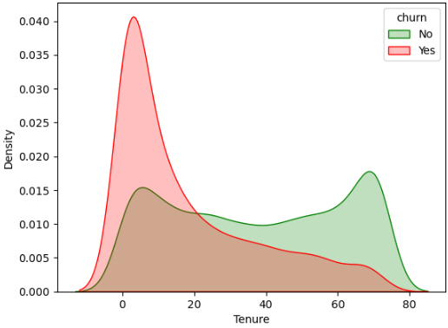
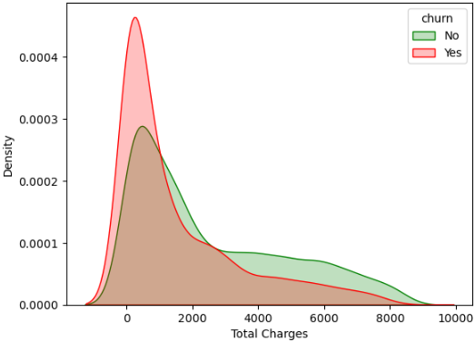
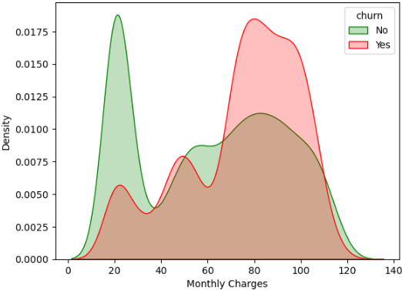
Customer Account and Churn [2/2]
Plots Insights:
Lower-tenured clients are more likely to churn
Less frequent churn occurs among clients with higher total charges
Higher monthly fees put clients at a greater risk of leaving

Slide 24

05 Features Engineering
Our objective now is to extract additional characteristics from raw data in order to improve the quality of results from the machine learning process instead of simply providing the raw data alone.

Slide 25
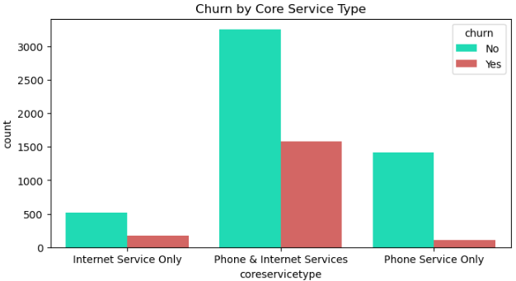
Core Service Type
We found the distribution of the core services during the EDA process; but does the churn rate vary across all core services?
Key Takeaways:
The graph demonstrates that the churn rates for each of the company's core services do vary
Customers who use both phone and internet services switch providers more frequently compared to customers who only use one main service
We can also notice the fact that just having a phone service significantly lowers the churn rate

Slide 26
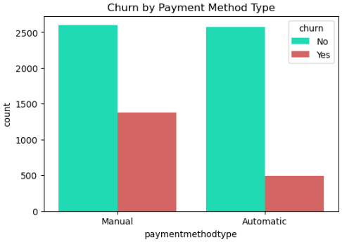
Payment Method Type
We discovered during EDA that clients can make payments using a variety of methods, including a credit card, an electronic check, a mailed check and a bank transfer. Additionally, it is stated whether a particular method supports automatic billing.
As a result, we made the decision to divide all methods into the "Manual" and "Automatic" categories and see if this affected the churn rate.
Key Takeaway:
Clients who use automatic billing are less likely to churn compared to those who do not

Slide 27
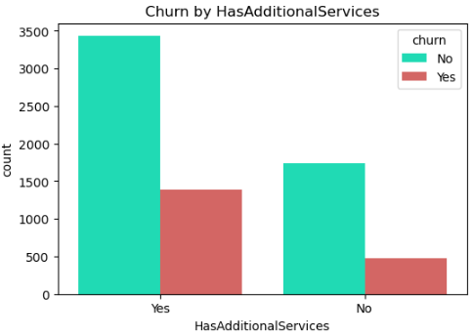
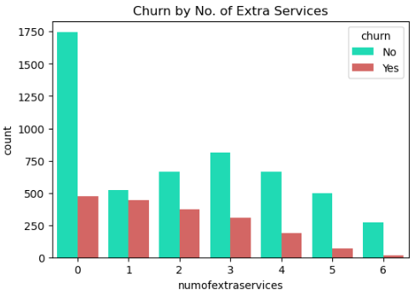
Number of Extra Services & Has Additonal Services
We found that clients can purchase up to 6 premium services, we also presented how the churn rate varies from a particular service to another. Following that discovery, we suspected that the amount of the additional subscribed services may be correlated with different client churn rates.
Key Takeaways:
Clients who do not purchase an add-on service are less likely to churn than those who do
The churn rate declines as the number of extra subscriptions rises

Slide 28
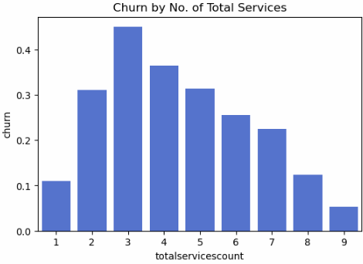
Number of Total Services
We discovered earlier that the quantity and kind of subscribed services affect the churn rate among customers.
Therefore, we were curious to see if there would be any variation in the churn percentages based on the total number of services that the customers are subscribed to.
Key Takeaways:
Up to three subscriptions, with each additional service customers subscribe to, the likelihood that they will cancel their subscription rises
Starting from three subscriptions, with each additional service customers subscribe to, the likelihood that they will cancel their subscription decreases

Slide 29
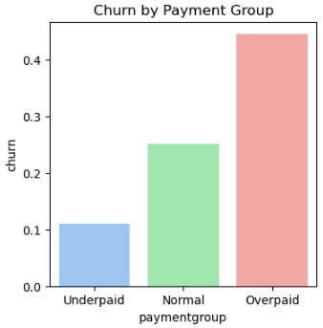
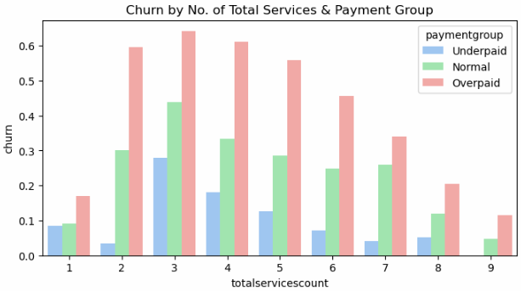
Payment Group
In general, a client's willingness to remain with a company is greatly influenced by the price he pays.
Since the services price is unknown, we discussed how to determine whether a specific client pays an excessive price, a normal price, or a price that is too low for the subscribed services.
We decided to look at the distribution of the clients’ monthly charges as a function of the number of total subscribed services.
A client will be classified as:
"Underpaid“, if the price he pays is less than that in the 25th percentile
"Overpaid“, if the price is greater than that in the 75th percentile
"Normal“, if it is between those two ranges
Key Takeaways:
Underpaid clients are less likely to leave than the other groups
Clients who pay an excessive price have the highest churn rate among all groups
Underpaid clients who purchased all services have never left the company

Slide 30
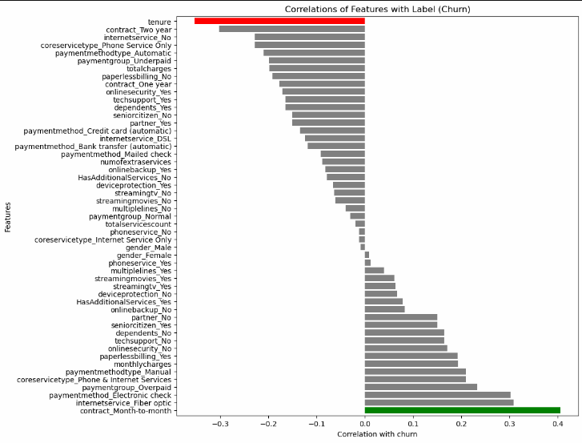

Correlations of Features With Label
The correlations between the chosen features and the churn rate are shown in this graph, sorted by increasing strength.
The feature with the strongest positive correlation is displayed in the green bar
The feature with the strongest negative correlation is displayed in the red bar

Slide 31
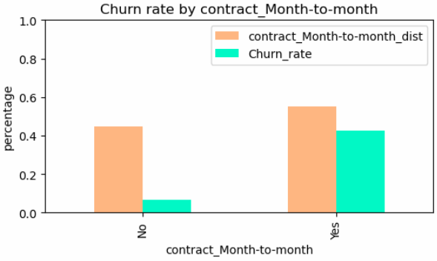
The Strongest Feature Correlated With Churn
The correlation graph shown earlier demonstrated that a monthly contract has the highest association with churn, so we wanted to dive deeper into its distribution and the related churn rate.
Key Takeaways:
Based on the distribution of that feature between a group of subscribers who share that characteristic and a group who do not, most of the clients have monthly subscriptions
Month-to-month contract group has much higher churn rate than the group of subscribers with other contract types

Slide 32

Preparations For The Model
CustomerID was removed because it doesn’t represent any meaningful information
Non-numeric features were converted to binary vectors using the function get_dummies()
Enriching the database with additional features:
totalservicescount
paymentgroup
HasAdditionalServices
paymentmethodtype
coreservicetype
All the remaining features were converted to data type float

Slide 33
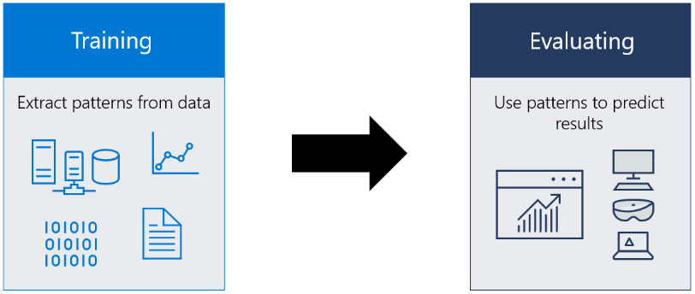
06 Model Evaluation
Machine learning model is trained using a set of data and an algorithm that allows it to analyze and learn from the data.
Once the model has been trained, we can use it to analyze data that it has never seen before and predict what will happen to this data.
In order to evaluate the model, 3 types of algorithms will be used:
Decision Tree (supervised learning)
Random Forest (supervised learning)
KNN (unsupervised learning)
Non-standardized
Standardized

Slide 34

Train-Test Split
As a preliminary step for the model, the data set was randomly split in the following way:
This will allow us to train a proper model with enough data and to evaluate it on data it has never seen before.
We can then use our test dataset to measure the performance of our model and pick the best hyperparameters (k in KNN, d in Decision Tree and Random Forest).
In order to do it, we stored the predictions results (both on train and test data) in a data frame along with the matching prediction accuracy.
 | Ratio | No. of Rows
Train Set | 80% | 5,634
Test Set | 20% | 1,409
Total | 100% | 7,043

Slide 35
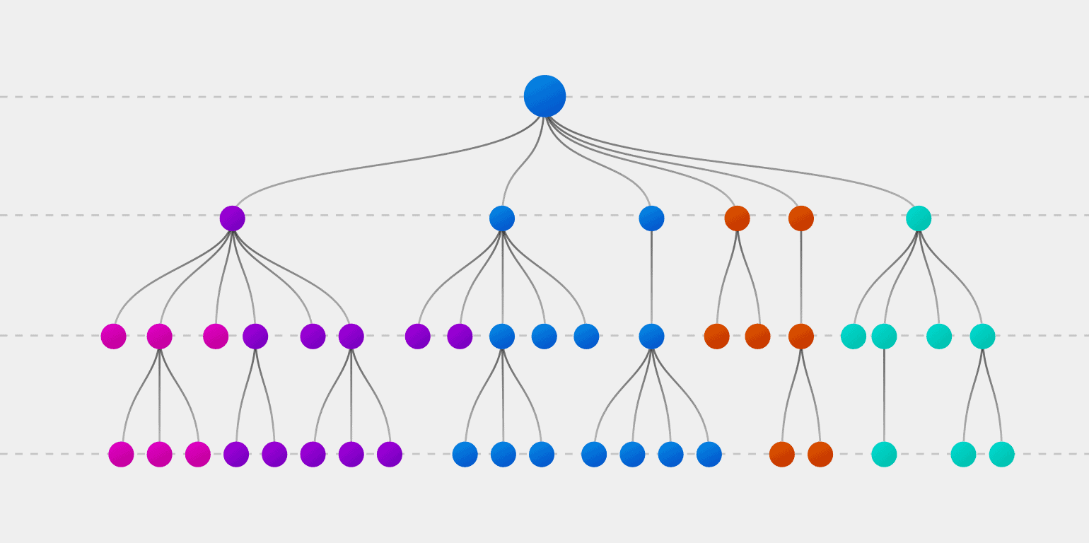
Decision Tree

Slide 36
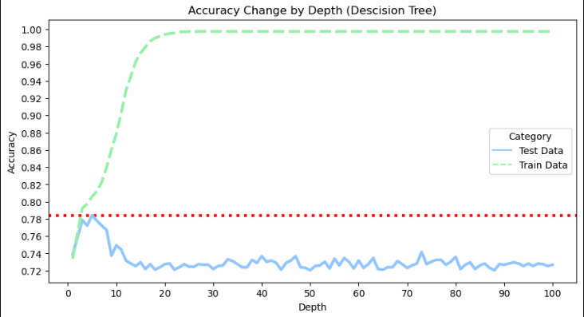
Decision Tree
We repeated the algorithm 100 times in order to prevent overfitting and compared the prediction outcomes between the train data and the test data. The algorithm was then run using the hyperparameter (max_depth) that produces the test set prediction with the highest accuracy.
Decision tree algorithm's best accuracy is 78.42% with depth of 5
(*) The dotted red line represents the maximum accuracy of the predictions on the test data

Slide 37
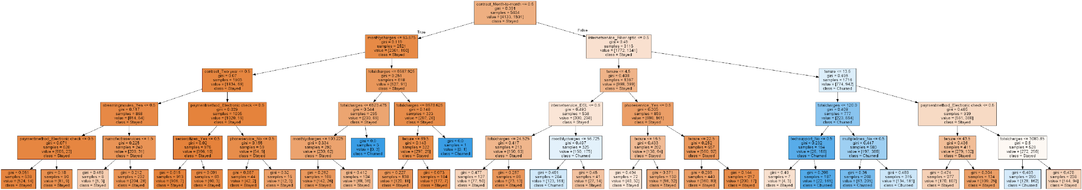
Decision Tree Plot
The algorithm uses a binary tree graph (each node has 2 children) to assign for each data sample a target value which is presented in the tree leaves (labels). To reach to the leaf, the sample is propagated through nodes, starting at the root node. In each node a decision is made (based on the selected sample’s feature) to which descendant node it should go.
A potential client who is likely to churn:
Has monthly contract -> has Fiber Optic internet service -> stays with the company up to 13.5 months -> total charged up to $120 -> doesn’t have tech support service

Slide 38

Random Forest

Slide 39
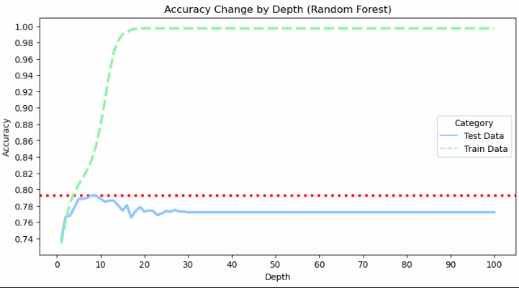
Random Forest
We repeated the algorithm 100 times in order to prevent overfitting and compared the prediction outcomes between the train data and the test data. The algorithm was then run using the hyperparameter (max_depth) that produces the test set prediction with the highest accuracy.
Random Forest algorithm's best accuracy is 79.28% with depth of 8
(*) In order to obtain a clear result, the n_estimators hyperparameter, which denotes the number of decision trees it generates, was set to 101 (an odd number)
(**) The dotted red line represents the maximum accuracy of the predictions on the test data

Slide 40


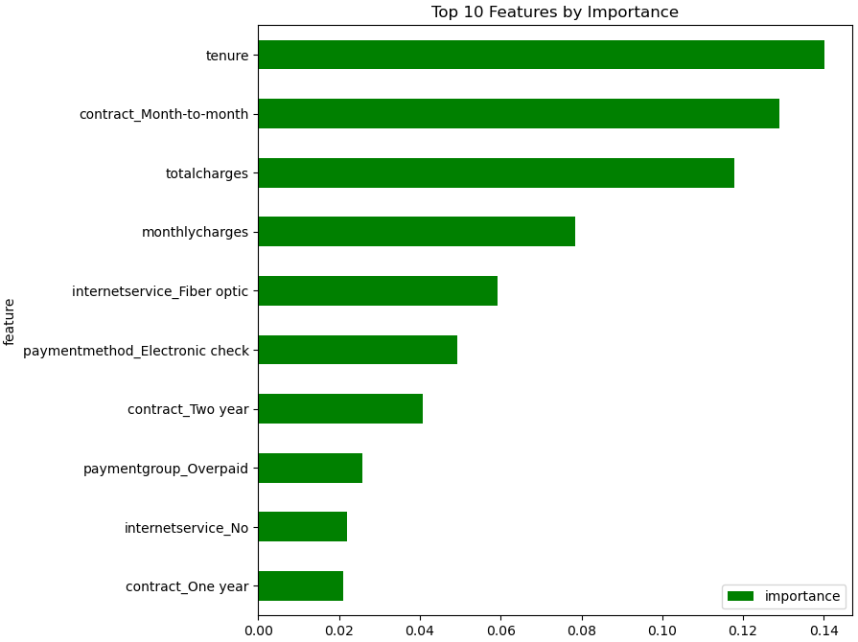
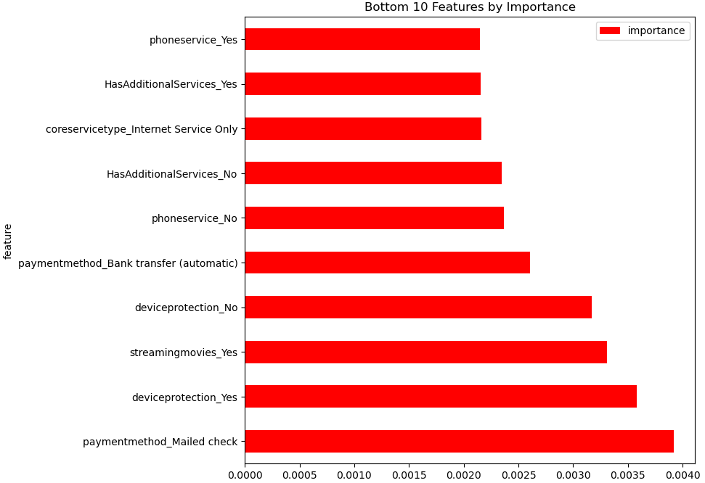
Random Forest
The features importance portrays which variables are significant. It can help with better understanding and sometimes lead to model improvements by employing the feature selection.

Slide 41

KNN – K Nearest Neighbors

Slide 42
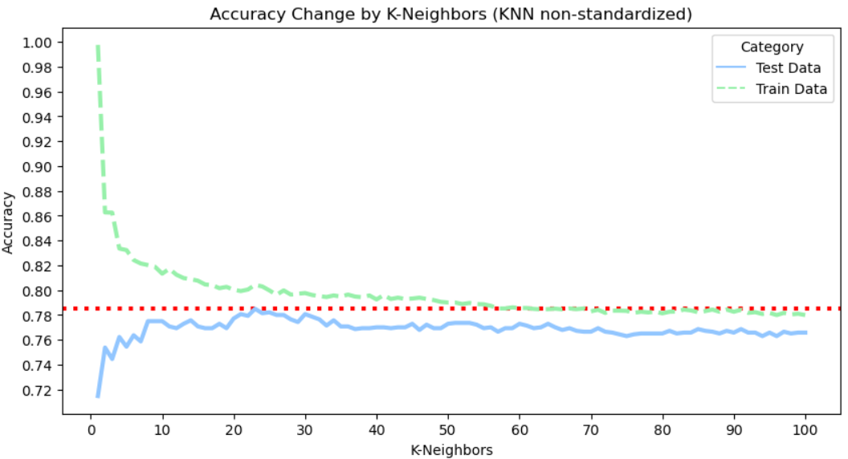
KNN – K Nearest Neighbors (Non-standardized)
We repeated the algorithm 100 times in order to prevent overfitting and compared the prediction outcomes between the train data and the test data. The algorithm was then run using the hyperparameter (n_neighbors) that produces the test set prediction with the highest accuracy.
KNN (non-standardized) algorithm's best accuracy is 78.50% with 23 neighbors
(*) The dotted red line represents the maximum accuracy of the predictions on the test data

Slide 43
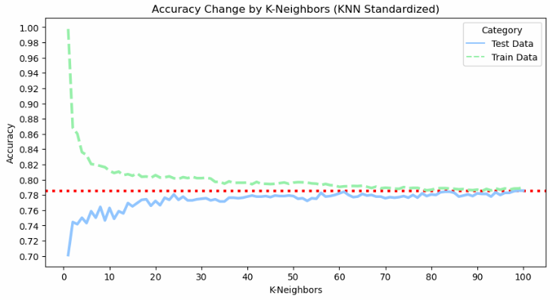
KNN – K Nearest Neighbors (Standardized)
We repeated the algorithm 100 times in order to prevent overfitting and compared the prediction outcomes between the train data and the test data. The algorithm was then run using the hyperparameter (n_neighbors) that produces the test set prediction with the highest accuracy.
KNN (Standardized) algorithm's best accuracy is 78.57% with 100 neighbors
(*) The accuracy was improved by 0.07% after standardization.
(**) The dotted red line represents the maximum accuracy of the predictions on the test data

Slide 44


Benchmark Algorithm
Our main goal in machine learning is to increase the model's precision so that it can accurately anticipate future customer churn
The traditional solution (benchmark) predicts future churns based on the leading label from our data set and is always applied to all cases
We should always compare our models to the benchmark algorithm’s accuracy in order to determine whether they are bettering the current situation
The leading label with 73.46% of the rows is No

Slide 45
Summary
 | Benchmark Algorithm’s Accuracy | Accuracy | Depth/ Neighbors | % Improvement
Decision Tree | 73.88% | 78.42% | 5 | +4.54%
Random Forest | 73.88% | 79.28% | 8 | +5.40%
KNN (Non-standardized) | 73.88% | 78.50% | 23 | +4.62%
KNN (Standardized) | 73.88% | 78.57% | 100 | +4.69%
The benchmark algorithm’s performance on test is 73.88%
We can see that any of our algorithms beat the benchmark’s performance
The leading model is Random Forest algorithm (79.28%) which improved the model’s accuracy by 5.40%

